Slide 1

Deep Learning
Session 14
Introduction to Recurrent Neural Networks (RNNs)
Applied Data Science
2024/2025

Slide 2
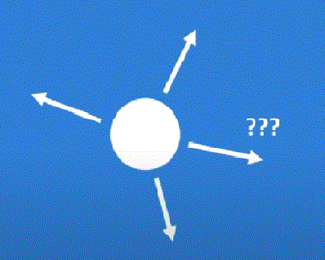
Given an image of a ball can you predict where it will go next?
Recurrent Neural Networks
Session 14

Slide 3
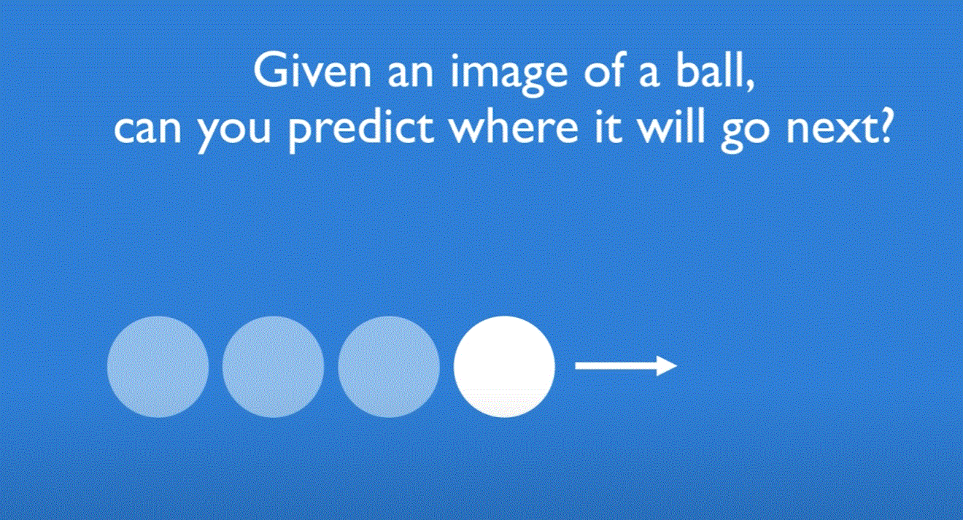
Given an image of a ball can you predict where it will go next?
Recurrent Neural Networks
Session 14

Slide 4
Given an image of a ball can you predict where it will go next?
Recurrent Neural Networks
Session 14

Slide 5
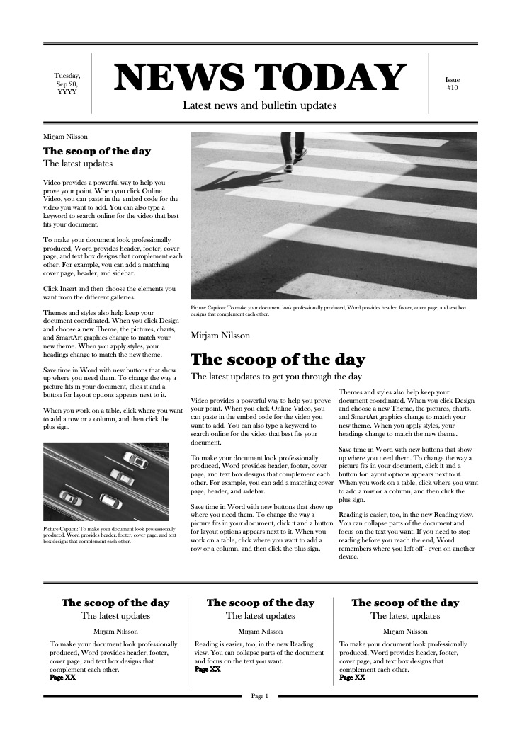
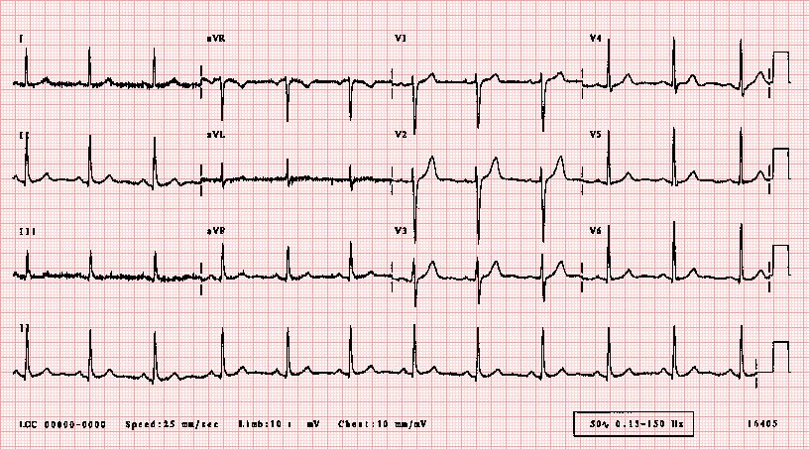
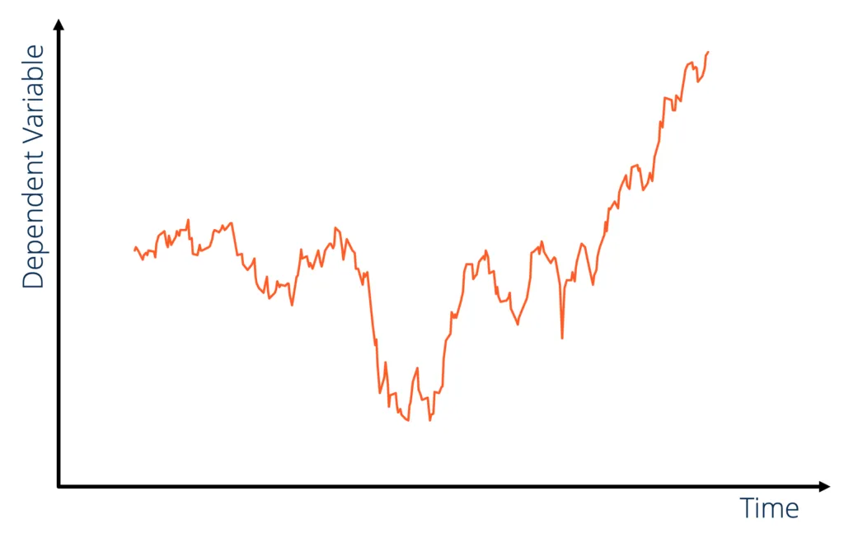

Sequential Data
Elements in a sequence occur in a certain order
Elements depend on each other
Recurrent Neural Networks
Session 14

Slide 6
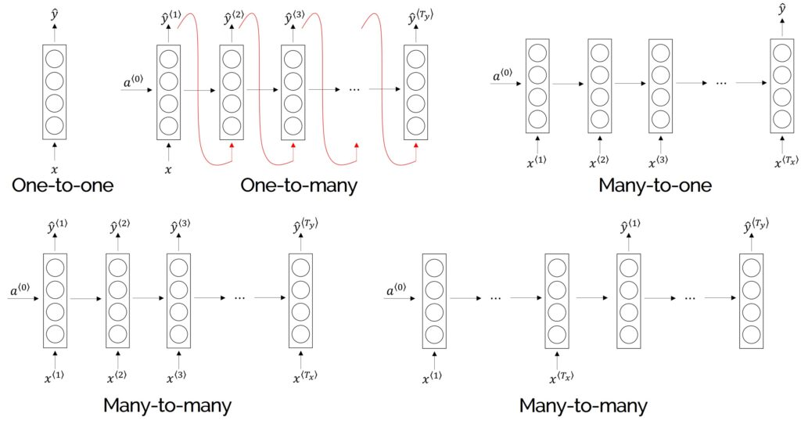
Sequence Applications: One-to-One
Description: Processes a single input to produce a single output. Typically used in traditional feedforward networks, not truly recurrent.
Recurrent Neural Networks
Session 14

Slide 7
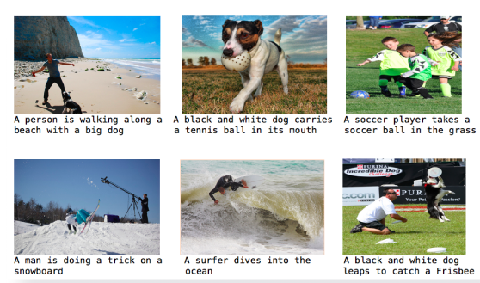
Sequence Applications: One-to-Many
Description: Takes one input and generates a sequence of outputs, often used for generating text or music.
Recurrent Neural Networks
Session 14

Slide 8

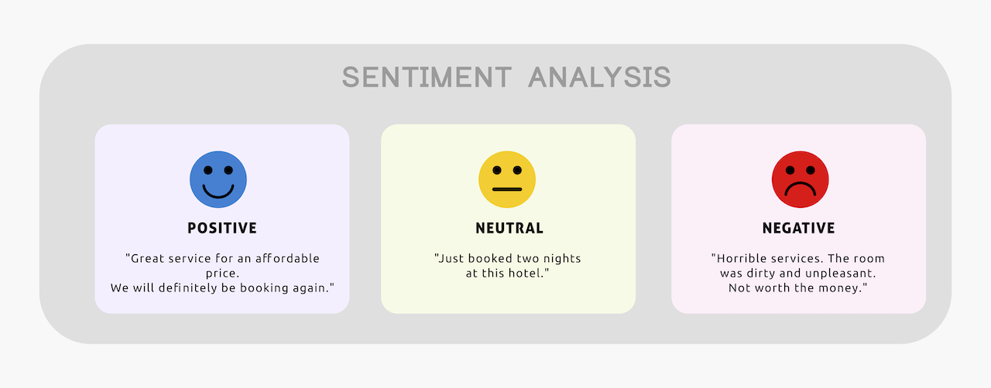
Sequence Applications: Many-to-One
Description: Takes a sequence of inputs and produces a single output, ideal for analyzing sequences.
Recurrent Neural Networks
Session 14

Slide 9
Sequence Applications: Many-to-Many
Description: Processes a sequence of inputs to generate a sequence of outputs, useful for tasks where both input and output are sequential.
Recurrent Neural Networks
Session 14

Slide 10
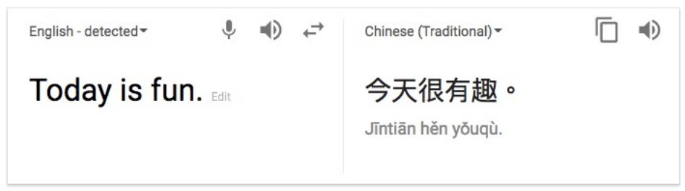
Sequence Applications: Many-to-Many
Description: Processes a sequence of inputs to generate a sequence of outputs, useful for tasks where both input and output are sequential.
Recurrent Neural Networks
Session 14

Slide 11
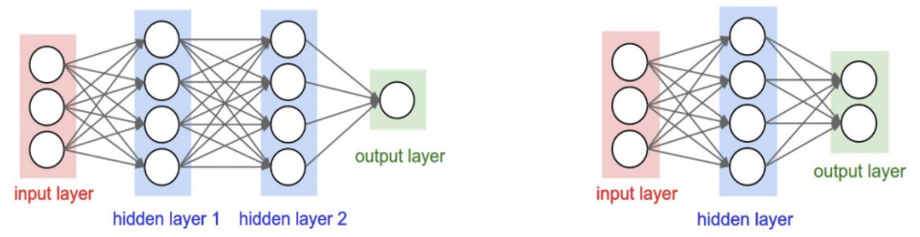
Recall: Feedforward Neural Networks
Problems:
Many model parameters;
Input / output sizes are fixed;
No memory of past since weights are learned independently.
Each layer serves as input to the next layer with no loops
Recurrent Neural Networks
Session 14

Slide 12
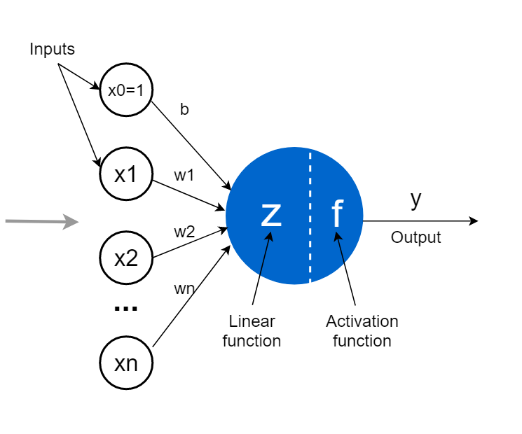
Recall: The Perceptron
Recurrent Neural Networks
Session 14

Slide 13
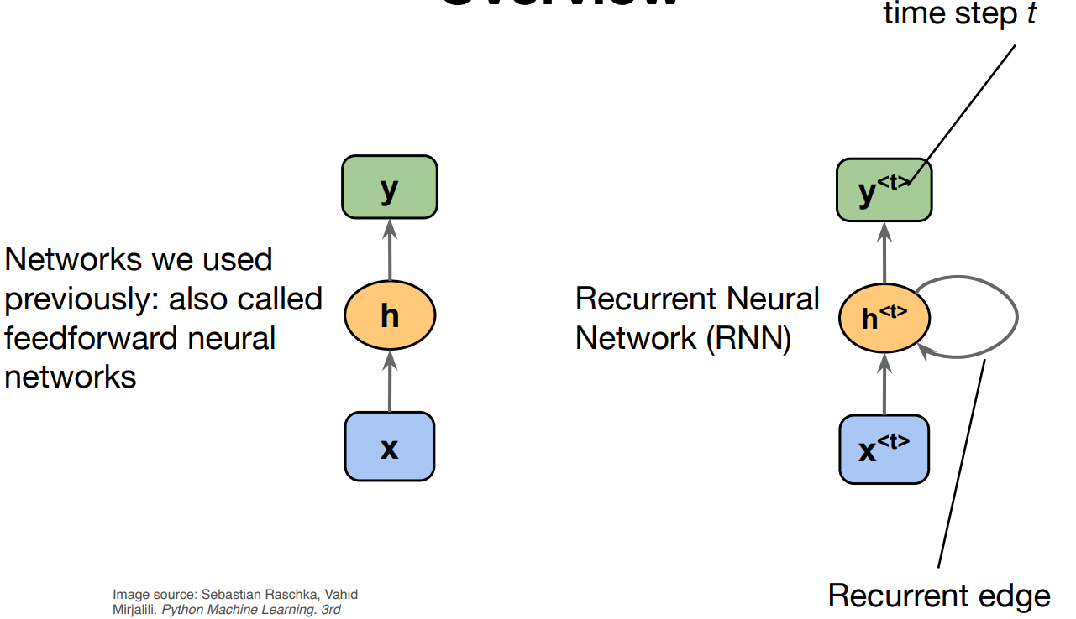
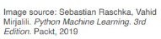
Recurrent Neural Networks (RNNs)
Main idea: use hidden state to capture information about the past
Receives input
from the previous layer
and from the output of the
previous time step
Receives input from
the previous layer with no loops.
Recurrent Neural Networks
Session 14

Slide 14
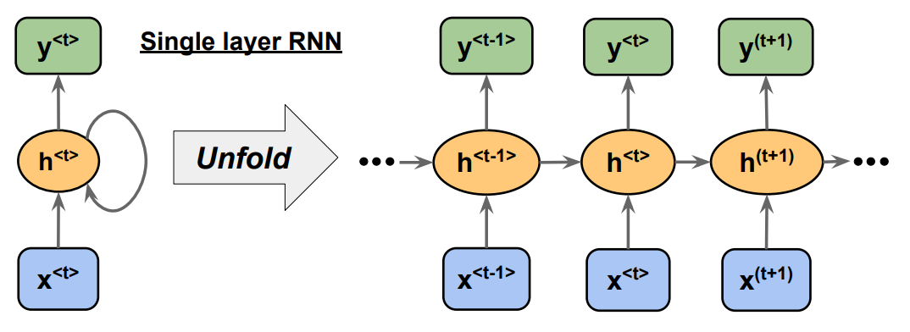
Recurrent Neural Networks (RNNs)
Recurrent Neural Networks
Session 14

Slide 15
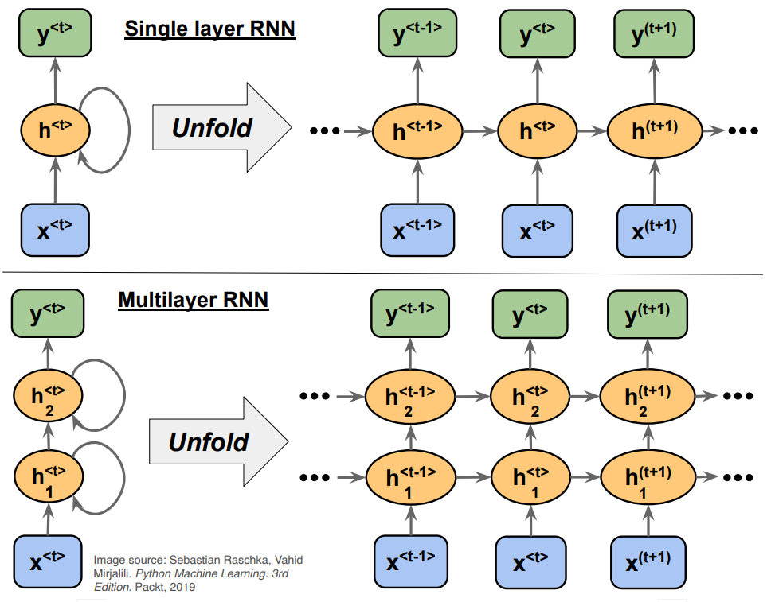
Recurrent Neural Networks (RNNs)
Recurrent Neural Networks
Session 14

Slide 16
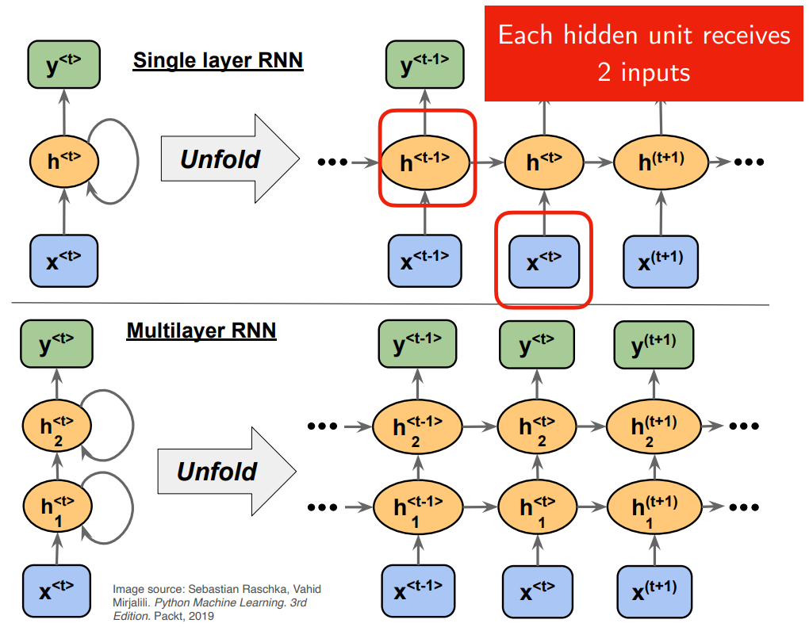
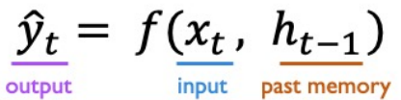
Recurrent Neural Networks (RNNs)
Recurrent Neural Networks
Session 14

Slide 17
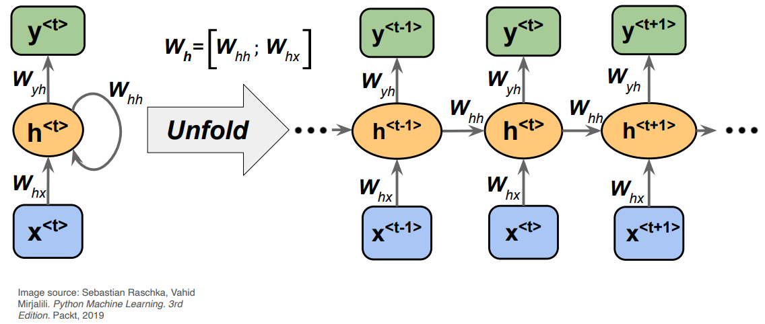
Backpropagation Through Time
Weight matrices in a single-hidden layer RNN
Recurrent Neural Networks
Session 14

Slide 18
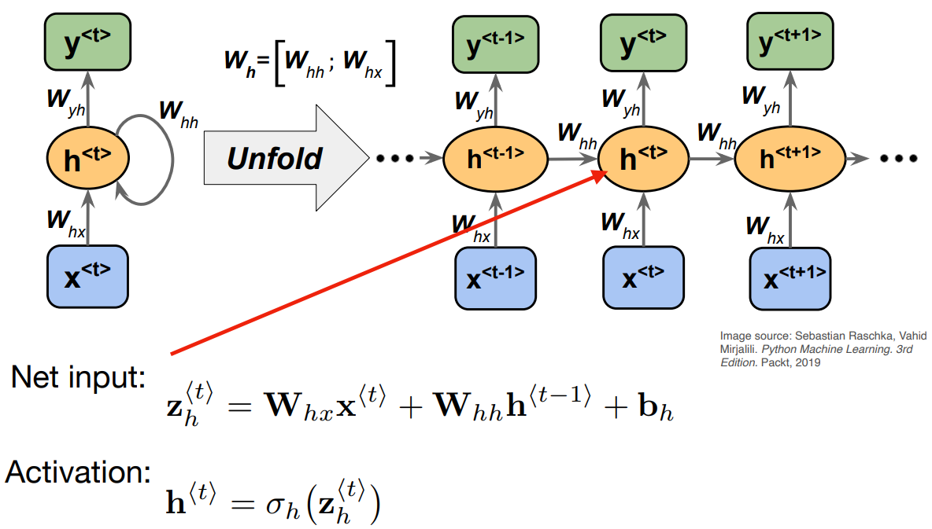
Backpropagation Through Time
Weight matrices in a single-hidden layer RNN
Recurrent Neural Networks
Session 14

Slide 19
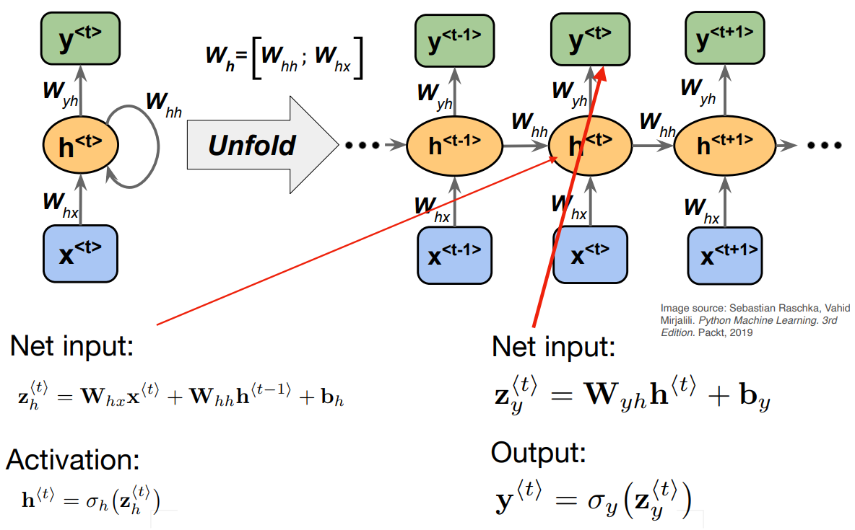
Backpropagation Through Time
Weight matrices in a single-hidden layer RNN
Recurrent Neural Networks
Session 14

Slide 20
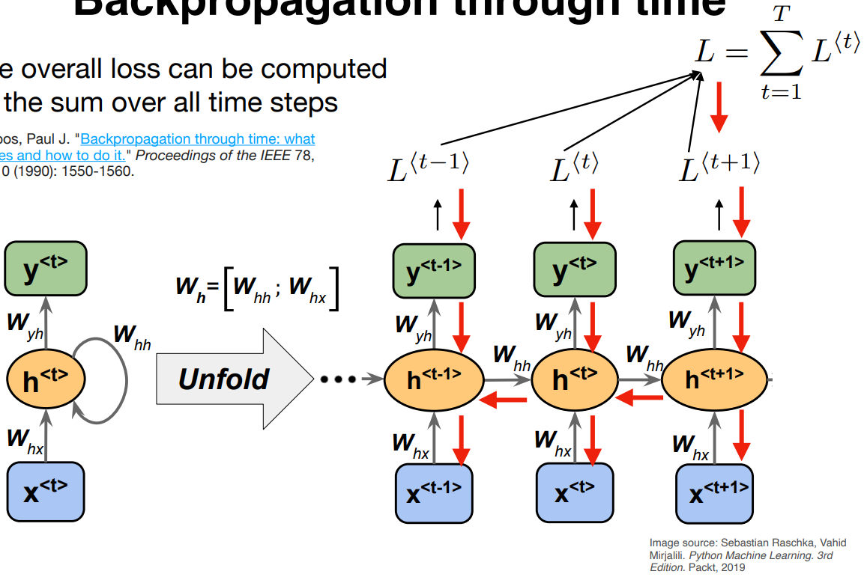
Backpropagation Through Time
The overall loss can be computed as the sum over all time steps
Recurrent Neural Networks
Session 14

Slide 21
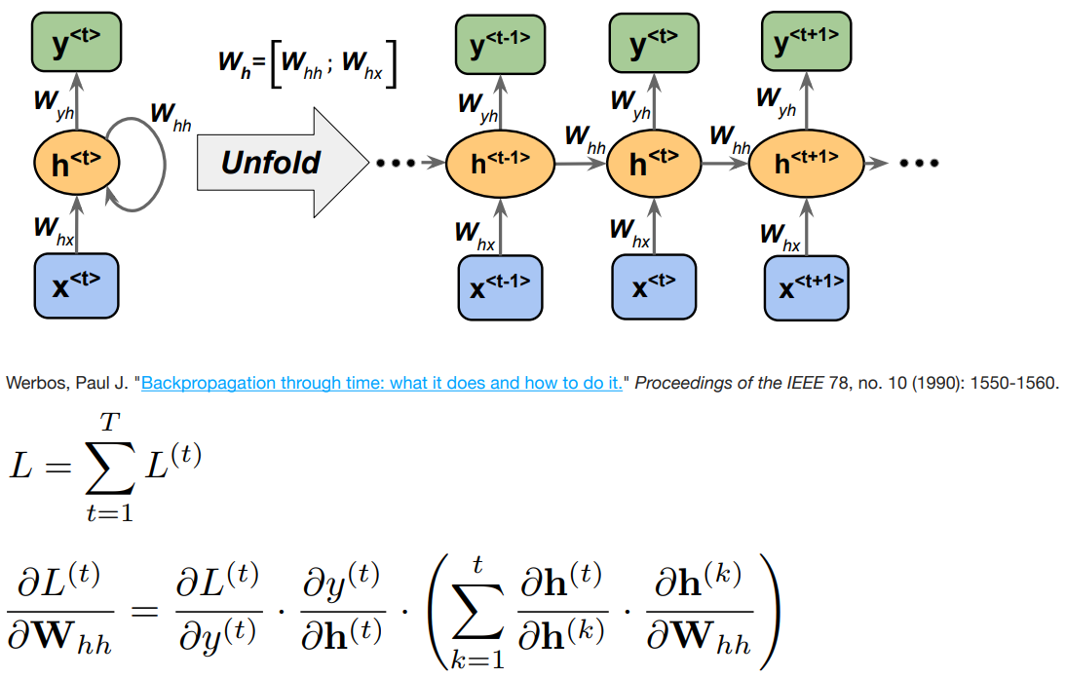
Backpropagation Through Time
Recurrent Neural Networks
Session 14

Slide 22
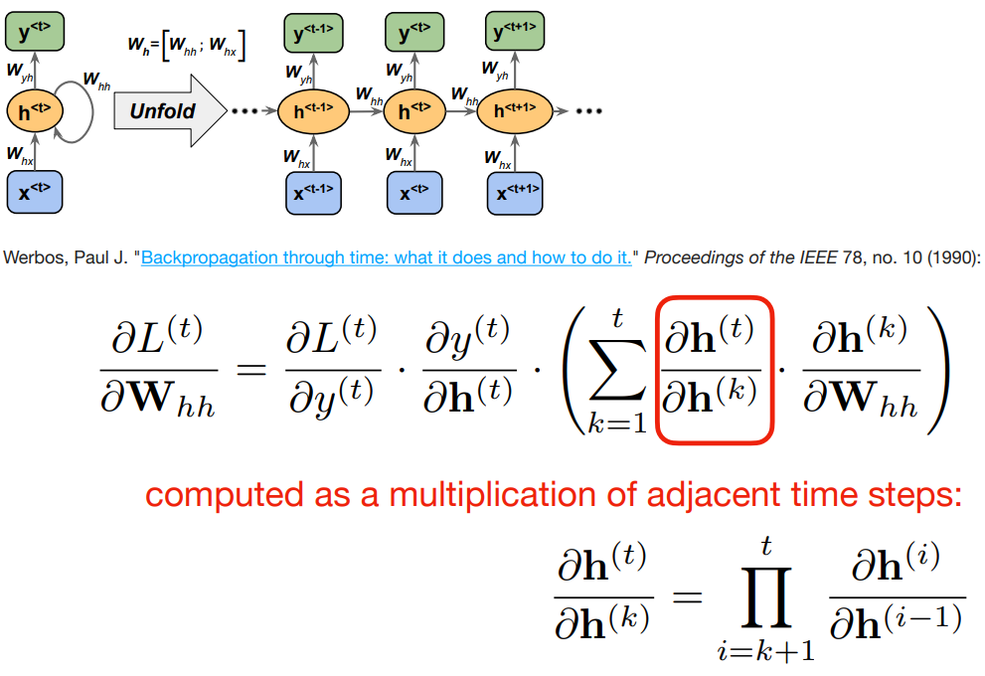
Backpropagation Through Time
Recurrent Neural Networks
Session 14

Slide 23
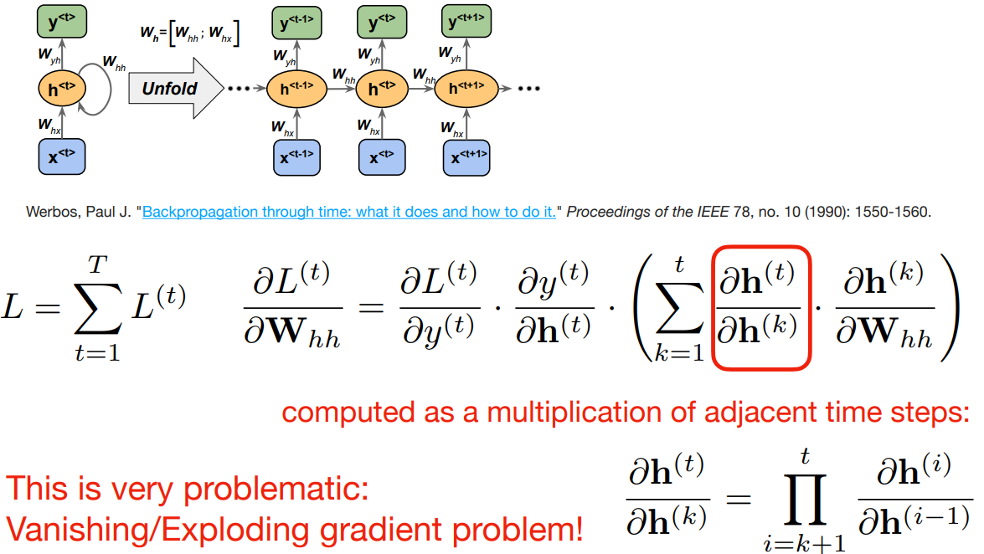
Backpropagation Through Time
Recurrent Neural Networks
Session 14

Slide 24
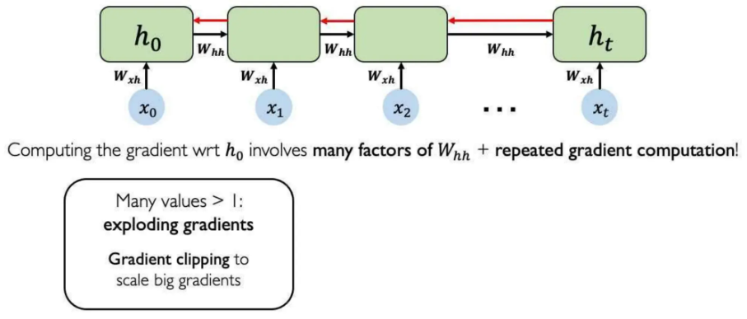
Standard RNN Gradient Flow: Exploding Gradients
Recurrent Neural Networks
Session 14

Slide 25
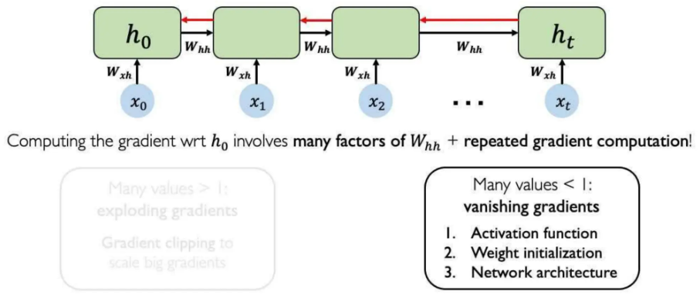
Standard RNN Gradient Flow: Vanishing Gradients
Recurrent Neural Networks
Session 14

Slide 26
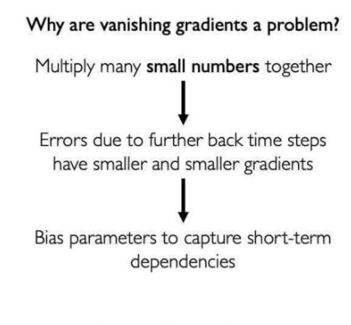
The Problem of Long-Term Dependencies
Recurrent Neural Networks
Session 14

Slide 27
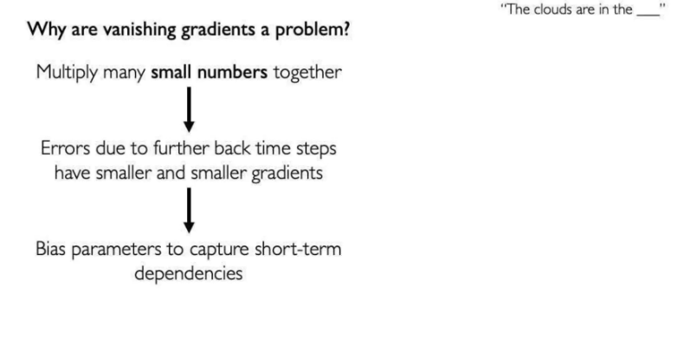
The Problem of Long-Term Dependencies
Recurrent Neural Networks
Session 14

Slide 28
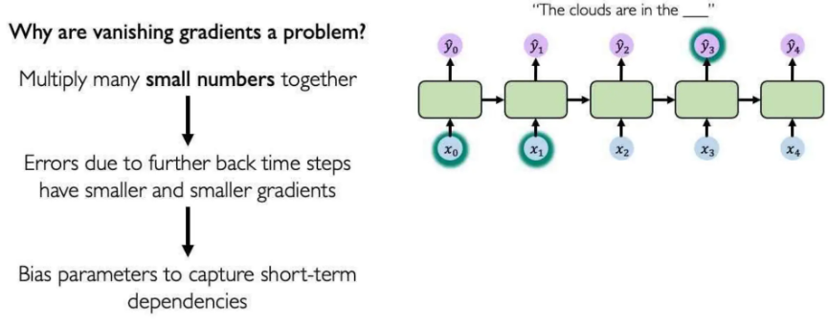
The Problem of Long-Term Dependencies
Recurrent Neural Networks
Session 14

Slide 29
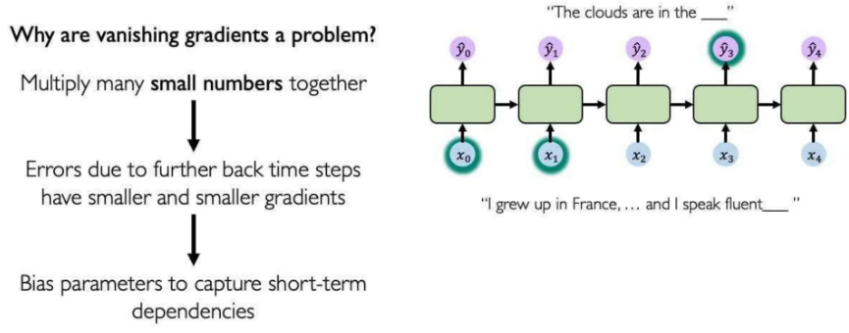
The Problem of Long-Term Dependencies
Recurrent Neural Networks
Session 14

Slide 30
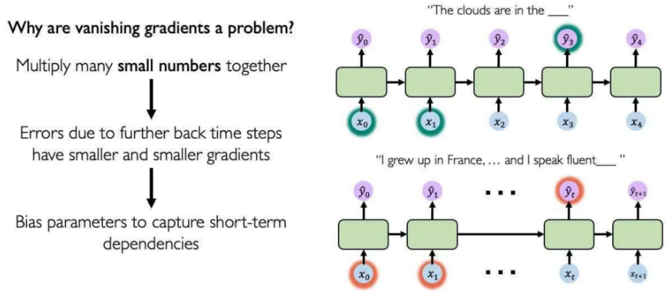
The Problem of Long-Term Dependencies
Recurrent Neural Networks
Session 14

Slide 31
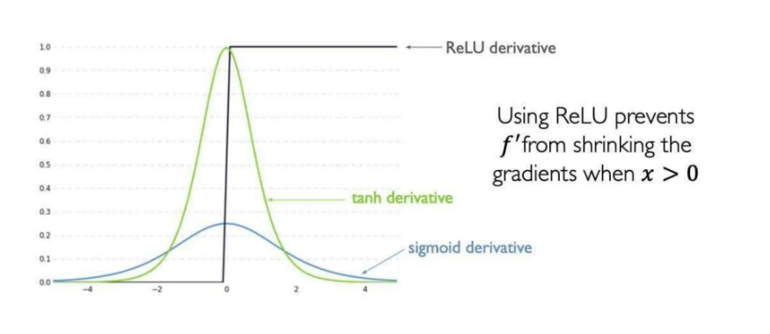
Solutions to the Vanishing/Exploding Gradients
Recurrent Neural Networks
Session 14

Slide 32
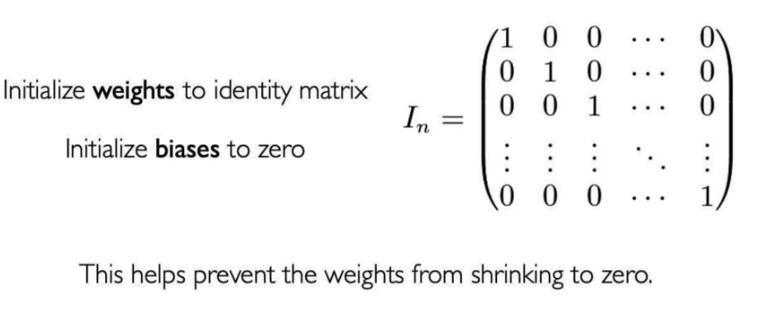
Solutions to the Vanishing/Exploding Gradients
Recurrent Neural Networks
Session 14

Slide 33
Solutions to the Vanishing/Exploding Gradients
Gradient Clipping: Set a maximum threshold for gradients to prevent them from becoming excessively large, effectively addressing the exploding gradient problem.
Truncated Backpropagation Through Time (TBPTT): Limits the number of time steps for which gradients are backpropagated after each forward pass. For example, with a sequence of 100 steps, TBPTT may only backpropagate through the most recent 20 steps.
Gated Cells: use gates to selectively add or remove information within each recurrent unit
Recurrent Neural Networks
Session 14

Slide 34
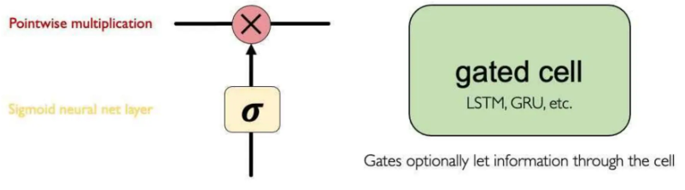
Gated Cells
Idea: use gates to selectively add or remove information within each recurrent unit
Long Short Term Memory (LSTM) networks rely on gated cells to tracj information throughout many time steps.
Recurrent Neural Networks
Session 14

Slide 35
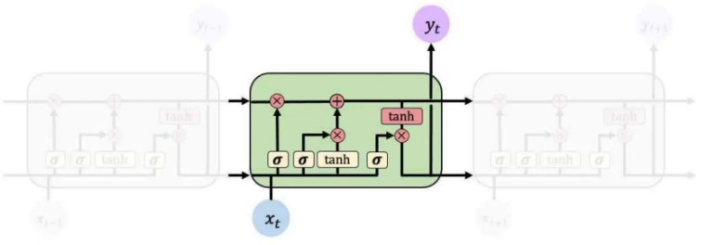
Long-Short Term Memory (LSTM)
Gated LSTM cells control information flow:
Forget 2) Store 3)update 4) Output
LSTM cells are able to track information throughout many timesteps
Recurrent Neural Networks
Session 14

Slide 36
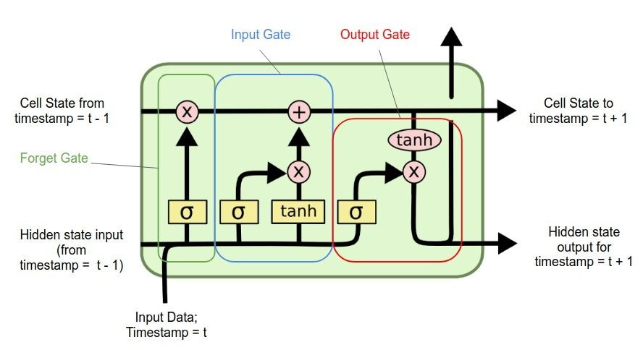
Long-Short Term Memory (LSTM)
Gated LSTM cells control information flow:
Forget 2) Store 3)update 4) Output
LSTM cells are able to track information throughout many timesteps
Recurrent Neural Networks
Session 14

Slide 37
LSTMs Key Concepts
Mantain a cell state
Use gates to control the flow of information
Forget gate gets rid of irrelevant information
Store relevant information from current input
Selectively update the cell state
Output gate returns a filtered version of the cell state
Backpropagation through time with partially uninterrupted gradient flow
Recurrent Neural Networks
Session 14

Slide 38
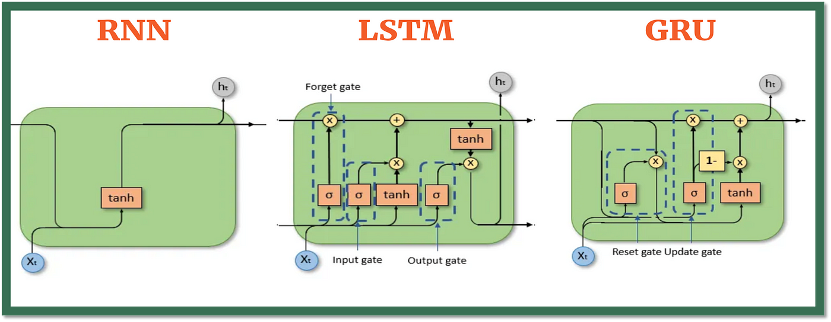
Gated Recurrent Unit (GRU)
Simplifies LSTM by merging: (1) cell and hidden states and (2) forget and input gates
Recurrent Neural Networks
Session 14

Slide 39
Simple RNN vs LSTM vs GRU
Recurrent Neural Networks
Session 14

Slide 40
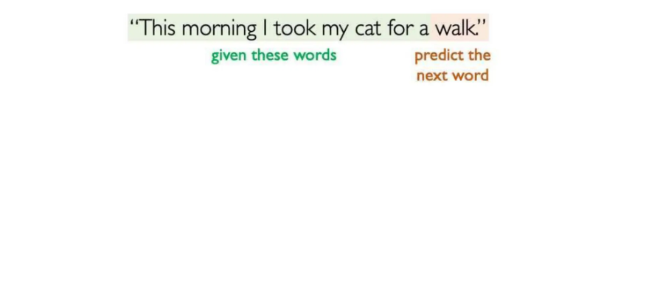
A Sequence Modeling Problem: Predict the Next Word
Recurrent Neural Networks
Session 14

Slide 41
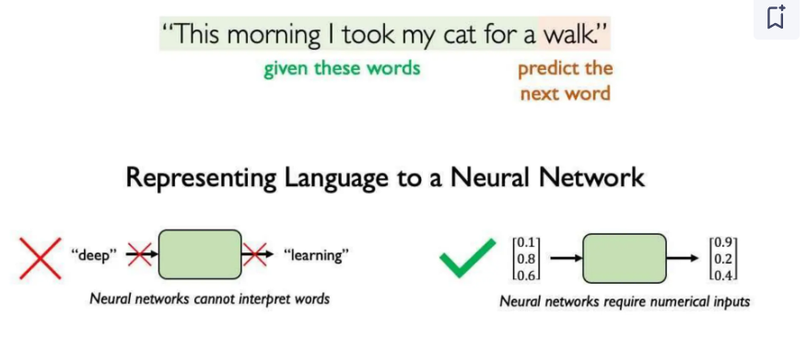
A Sequence Modeling Problem: Predict the Next Word
Recurrent Neural Networks
Session 14

Slide 42
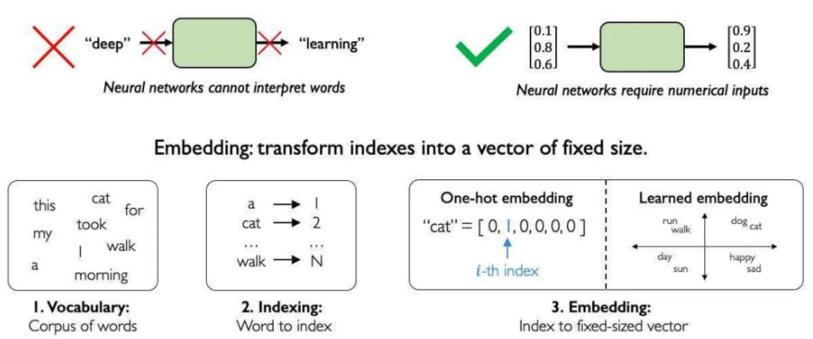
A Sequence Modeling Problem: Predict the Next Word
Recurrent Neural Networks
Session 14

Slide 43
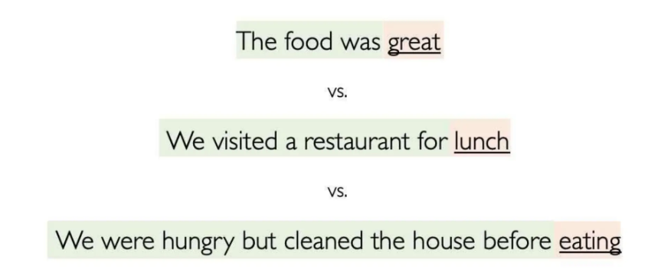
Handle Variable Sequence Lenghts
Recurrent Neural Networks
Session 14

Slide 44
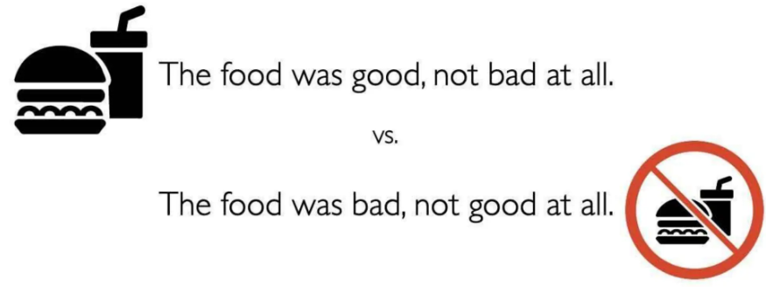
Capture Differences in Sequence Order
Recurrent Neural Networks
Session 14

Slide 45
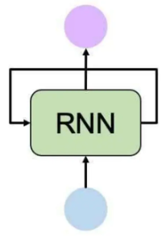
Sequence Modeling: Design Criteria
To model sequences, we need:
Handle variable-lenght sequences
Track long-term depencencies
Mantain information about order
Share parameters across the sequence
RNNs meet these sequence modeling design criteria
Recurrent Neural Networks
Session 14

Slide 46
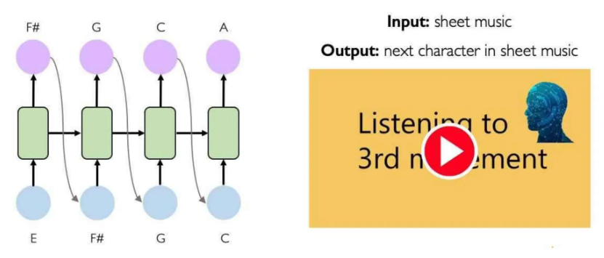
RNNs Applications and Limitations
Example Task: Music Generation
Recurrent Neural Networks
Session 14

Slide 47
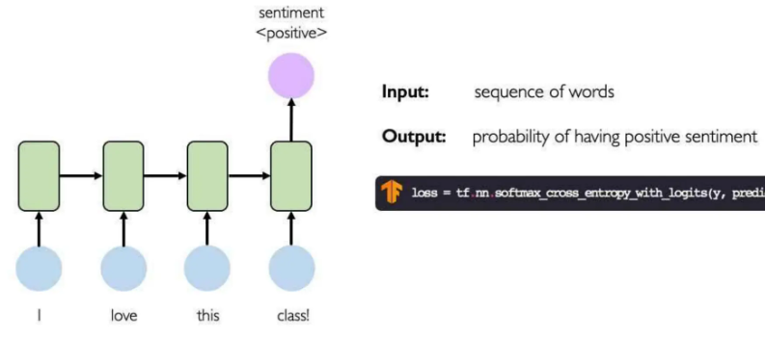
RNNs Applications and Limitations
Example Task: Sentiment Classification
Recurrent Neural Networks
Session 14

Slide 48
RNNs Applications and Limitations
Limitations of RNNs:
Encoding bottleneck
Slow, no parallelization
Not long memory
Recurrent Neural Networks
Session 14

